Slide 1
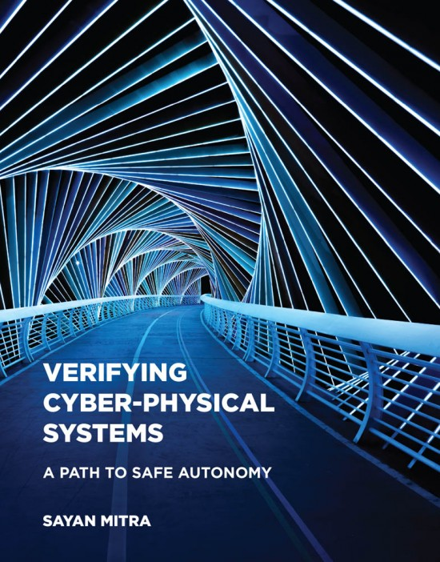
Chapter 6: Specifying Requirements
Abenezer Taye
Apr 20, 2022

Slide 2
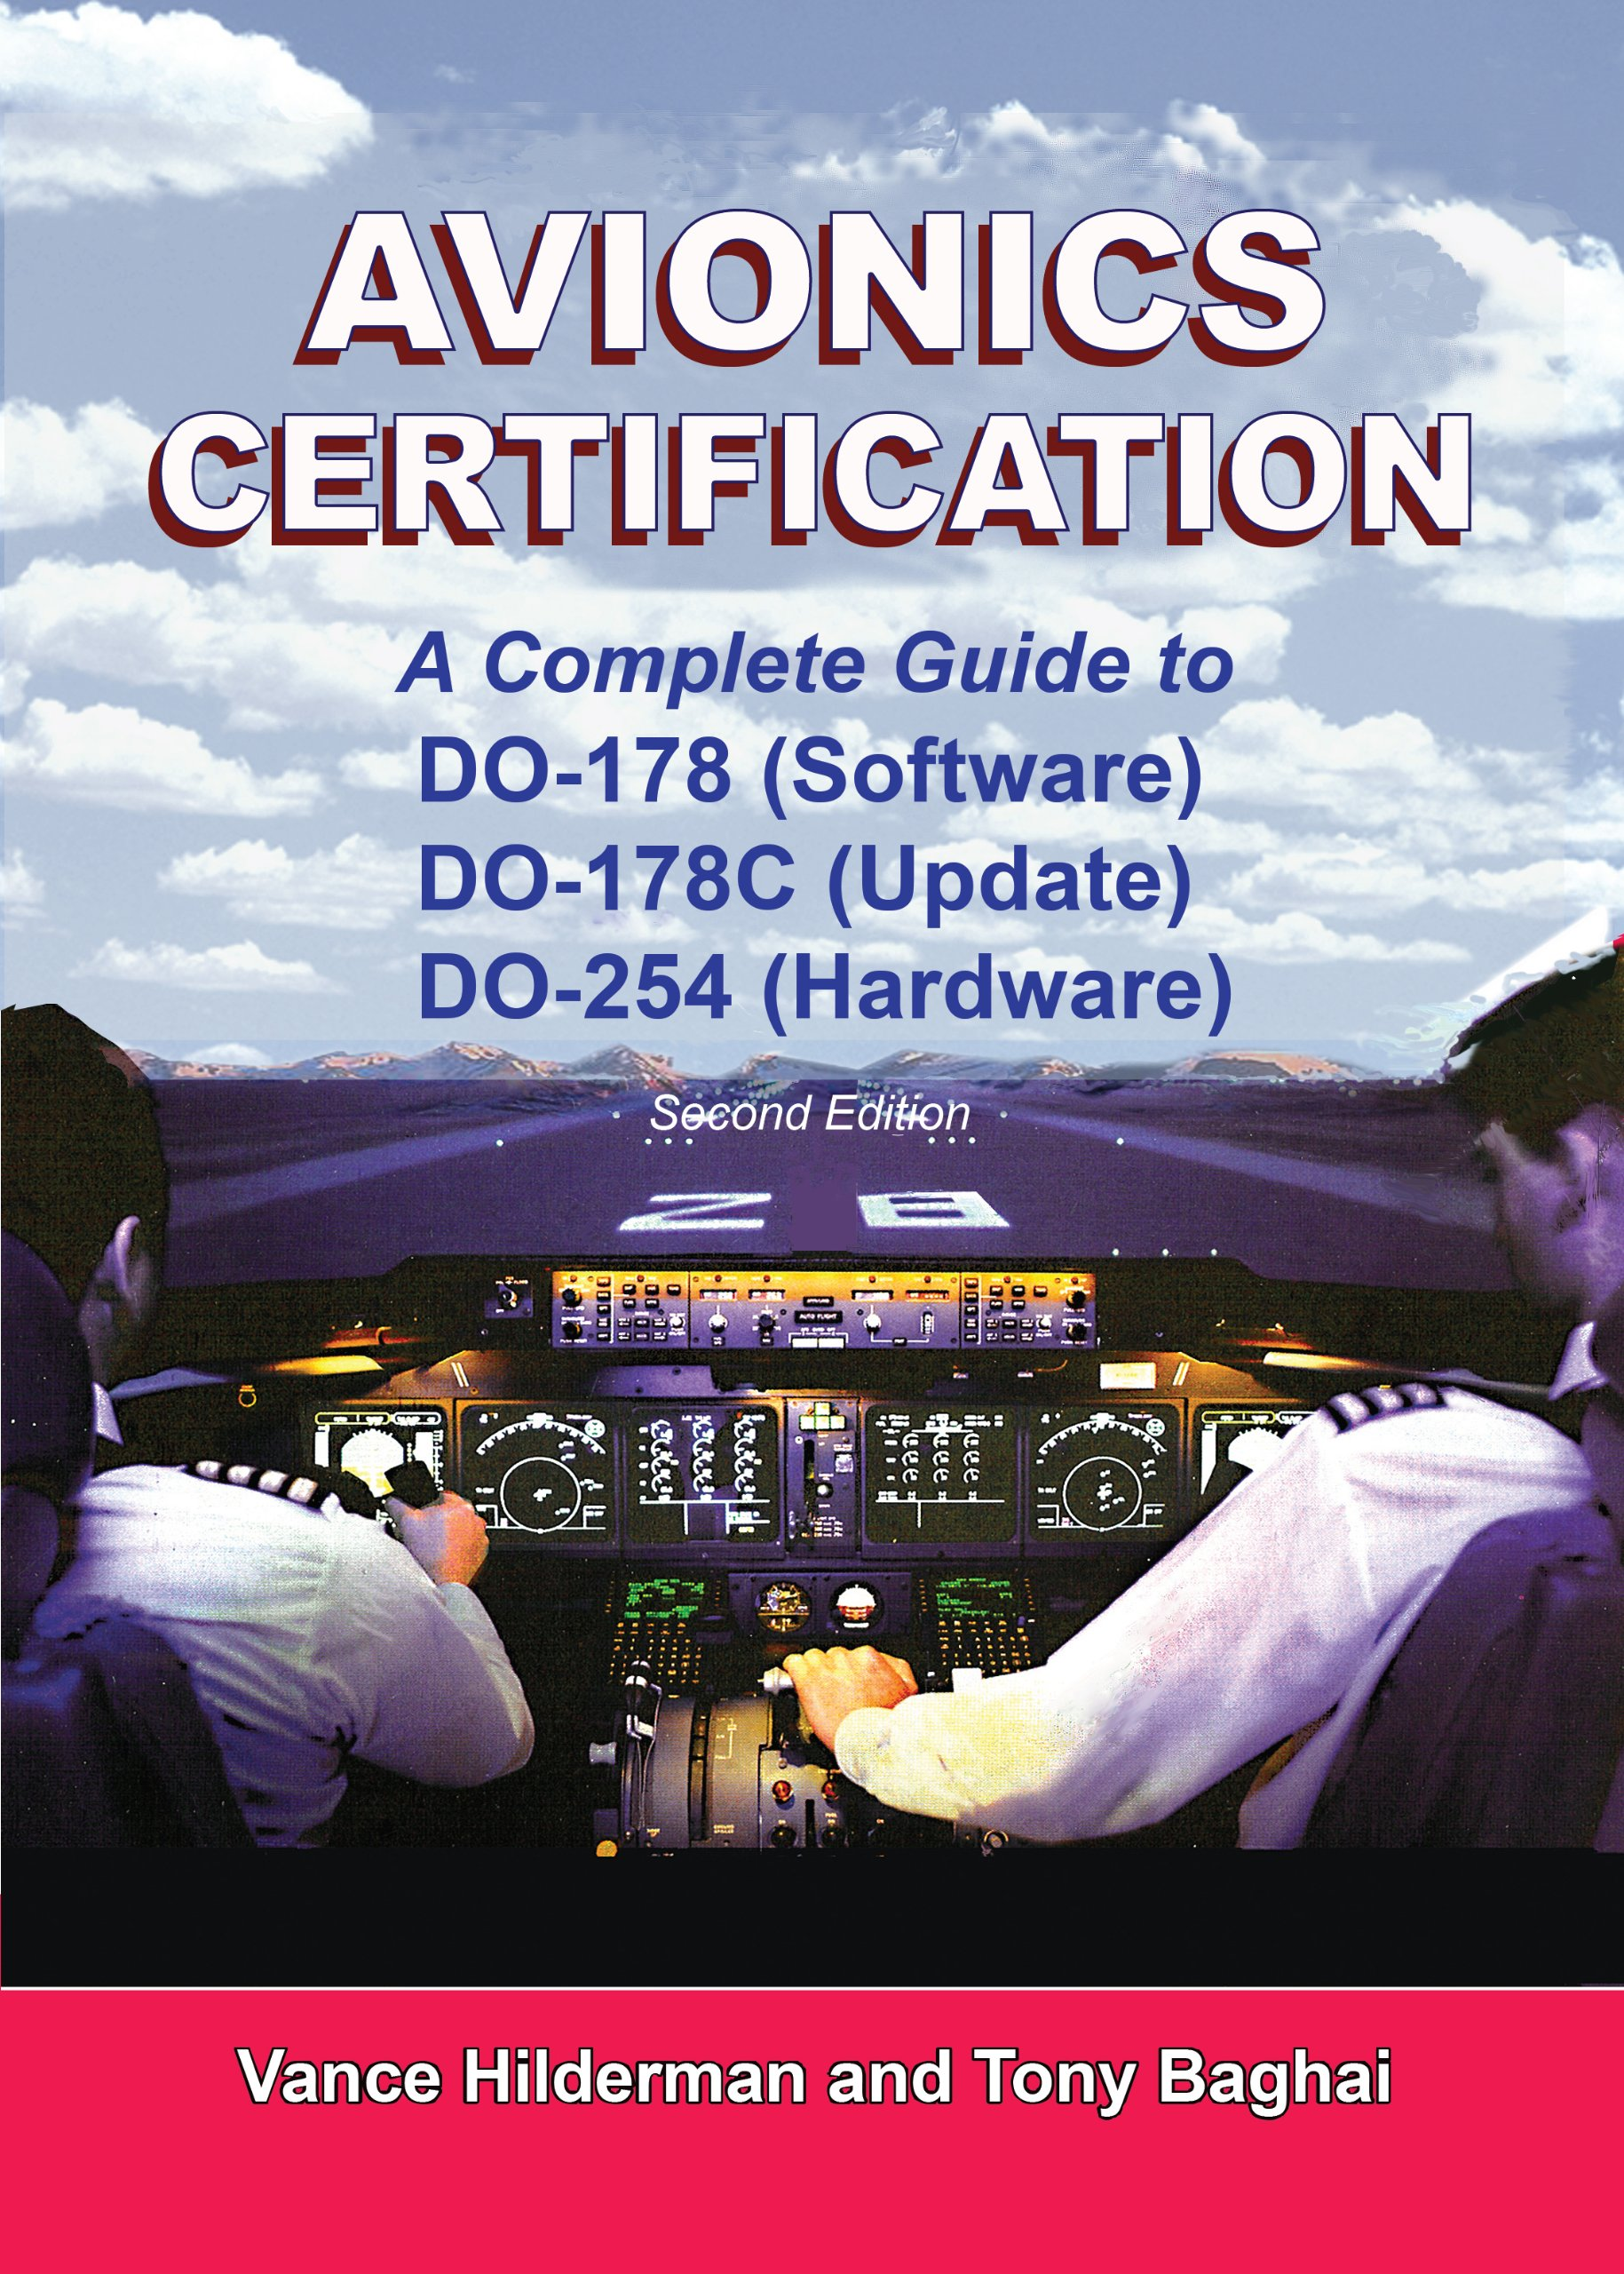
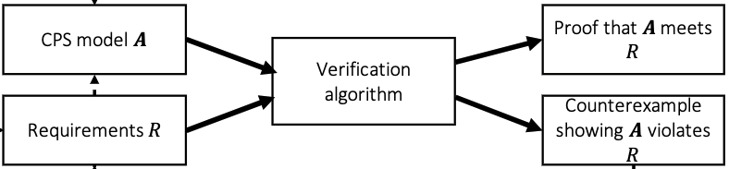
Safety Standards
The verification process looks like:
Design requirement documents: describe the capabilities, functions, and operations of a system.
Safety standards: provide guidelines and processes for developing safety-critical systems
DO-178C: a standard given by FAA for determining and certifying the airworthiness of aviation software

Slide 3
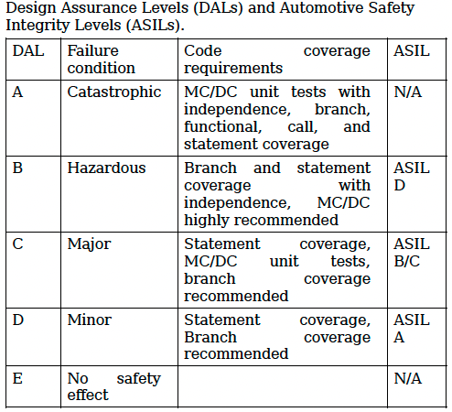
Safety Standards
DO-178C: Has five assurance levels for software modules (aka Design Assurance Levels (DALs))
Categorizes failure conditions by their effects on the aircraft, crew, and passenger.
Modified Condition/Decision Coverage (MC/DC) is a test suite that requires
Each entry and exit point in the code be invoked
Each decision take every possible value
Each condition in a decision take every possible value

Slide 4
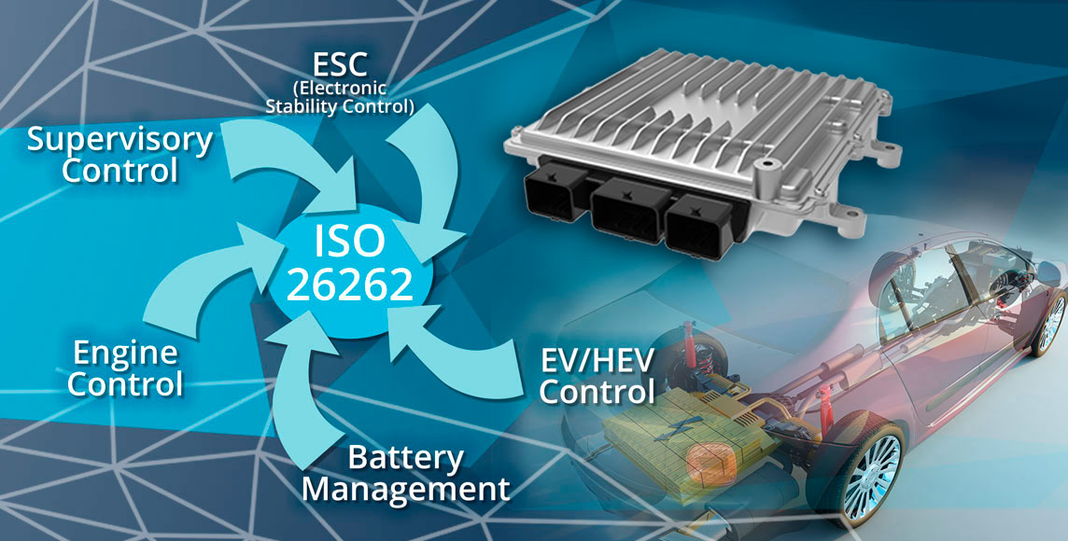
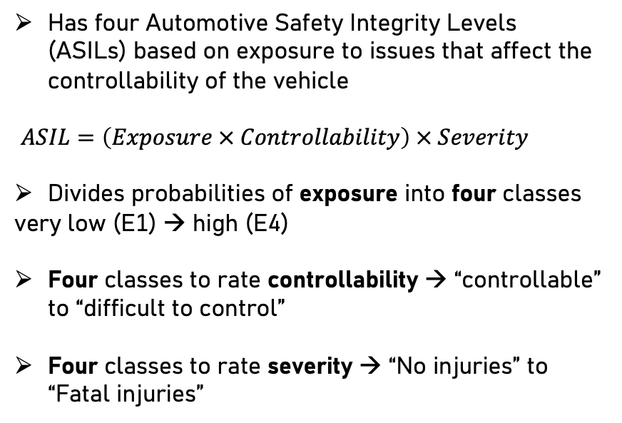
Safety Standards
ISO 26262: a standard governing the functional safety of electronic and software components in road vehicles
Has four Automotive Safety Integrity Levels (ASILs) based on exposure to issues that affect the controllability of the vehicle
$ASIL=\left(Exposure × Controllability\right) × Severity$
Divides probabilities of exposure into four classes
very low (E1) → high (E4)
Four classes to rate controllability → “controllable” to “difficult to control”
Four classes to rate severity → “No injuries” to “Fatal injuries”
A component that must be relied upon in a situation that has a medium probability of occurrence, and is considered normally controllable but can result in life-threatening injuries → requires an ASIL of B

Slide 5

Challenges of safety standards
Safety standards are useful for dealing with many potential design and implementation defects.
However, research shows many areas of autonomous systems are not covered by existing standards
The role of human effort in the task of verification and validation
Encoding the requirements and models in a verification tool
Validating the models (checking that the models indeed correspond to the real system)
Interpreting the output results of the verification tool
There is no agreed-upon definition for precisely accounting for these human efforts

Slide 6


Safety requirements
Invariant: captures the idea that “some things always hold” or equivalently, “bad things never happen”.
A candidate invariant I is an invariant if all states along all executions of A satisfy I
Progress requirements: captures the idea that “something good eventually happens”
Automaton A is said to meet progress requirement if every execution of A eventually reaches P.
A more meaningful version of progress is captured by asymptotic stability → requires all executions of A to converge to P as time goes to infinity.
A stronger version of progress bounds the time within which P must be achieved

Slide 7
Formal Languages to specifying requirements
Temporal Logics: a family of formal languages for succinctly specifying complex requirements
Temporal refers to the sequential ordering of certain actions or predicates in the execution of an automaton
Branching logics: allow quantification over execution (Computational Tree Logic (CTL))
Linear logics: do not allow quantification over execution (Linear Temporal Logic (LTL))
Temporal logic
Linear Logics
Branching Logics

Slide 8

Linear Temporal Logic (LTL)
Consider the program
LTL semantics
$¬ \left(not\right), ∨\left(or\right), ∧\left(and\right), →(implies)$are propositional connectives
$∘\left(X\right)\left(next\right),♢\left(F\right)\left(eventually\right),▯\left(G\right)\left(always\right), \left(U\right)\left(until\right)$ are temporal connectives
While (x<3){ print (“hello”) if (x==1) print (“hi”); if (x==2) x=0; else x++; }
Atomic Propositions p→ “prints hello” q→ “prints hi” r→ ”x is even”
Temporal Patterns Always p holds Always p implies (q or r) Never (q and r) holds Always eventually q holds
p,r
p,q
p,r
p,q
x←0
x←1
x←2
x←0
$¬, ∘,♢,▯$ are unary connectives (have high precedence than binary connectives) $∨, ∧, →, U$ are binary connectives

Slide 9
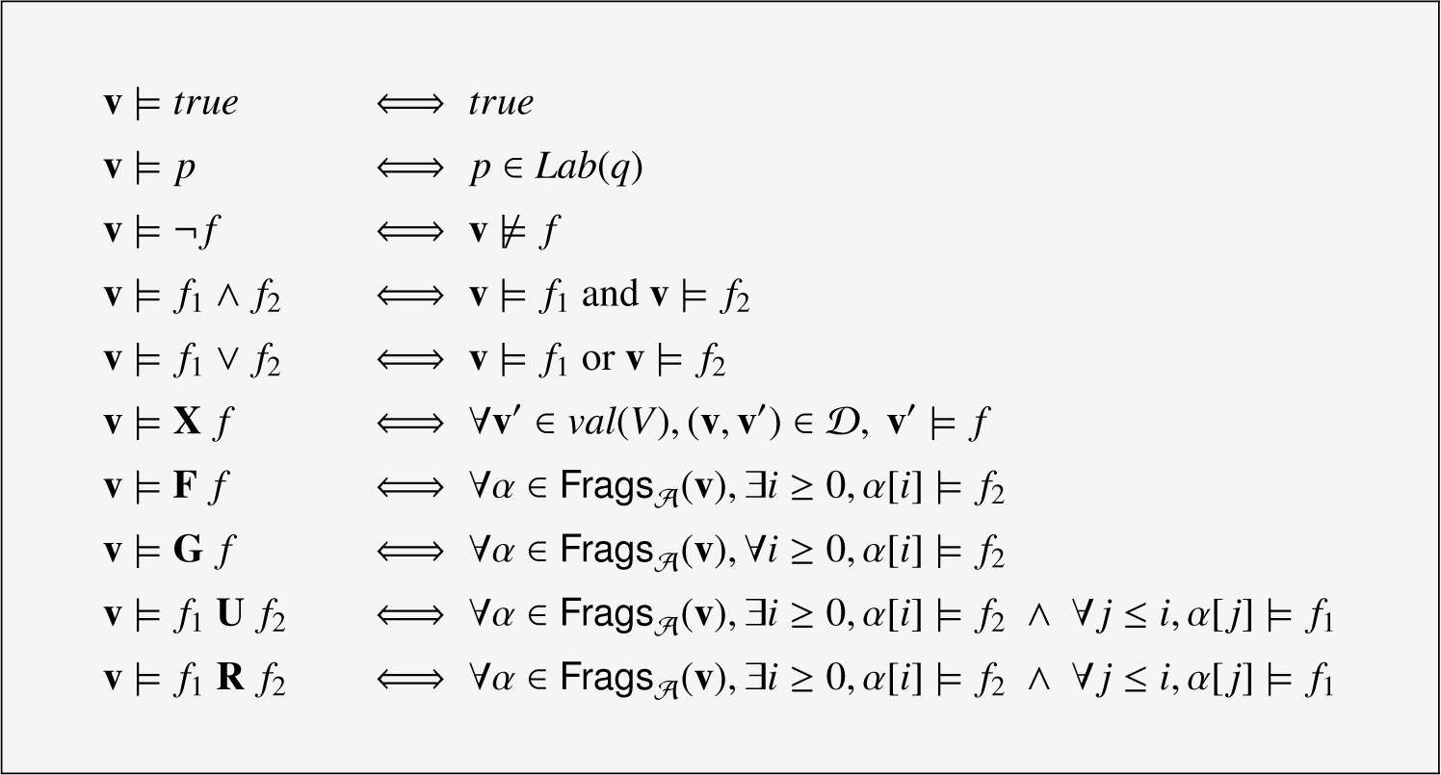
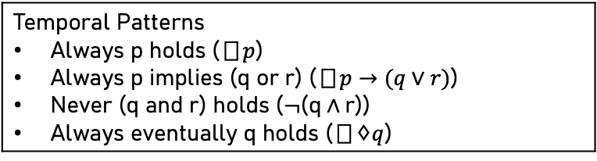
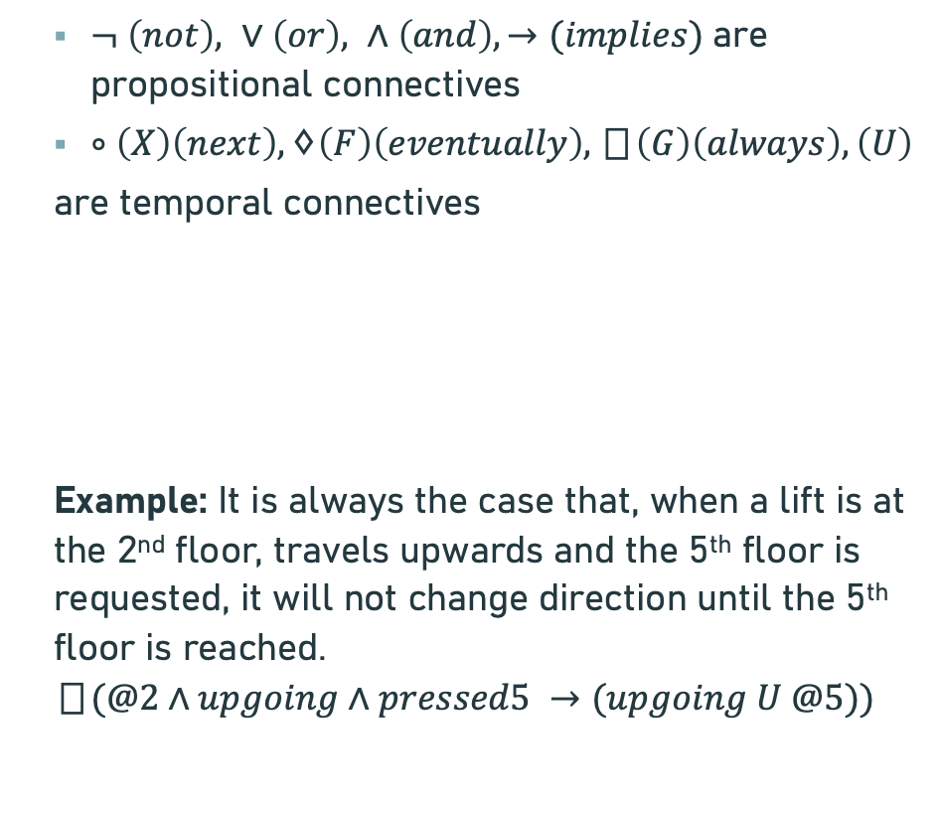
Linear Temporal Logic (LTL)
$¬ \left(not\right), ∨\left(or\right), ∧\left(and\right), →(implies)$are propositional connectives
$∘\left(X\right)\left(next\right),♢\left(F\right)\left(eventually\right),▯\left(G\right)\left(always\right), \left(U\right)$
are temporal connectives
Example: It is always the case that, when a lift is at the 2nd floor, travels upwards and the 5th floor is requested, it will not change direction until the 5th floor is reached.
$$▯(@2∧upgoing∧pressed5 →(upgoing U @5))$$
Key assumption in LTL: for every state on the path, assume to know which atomic statements are true in that state
Formal semantics
Lab is a labeling function that assigns each state a set of atomic propositions
Temporal Patterns Always p holds ($▯p$) Always p implies (q or r) ($▯p→(q∨r)$) Never (q and r) holds ($¬\text{(}\text{q}∧\text{r}\text{))}$ Always eventually q holds ($▯♢q$)

Slide 10
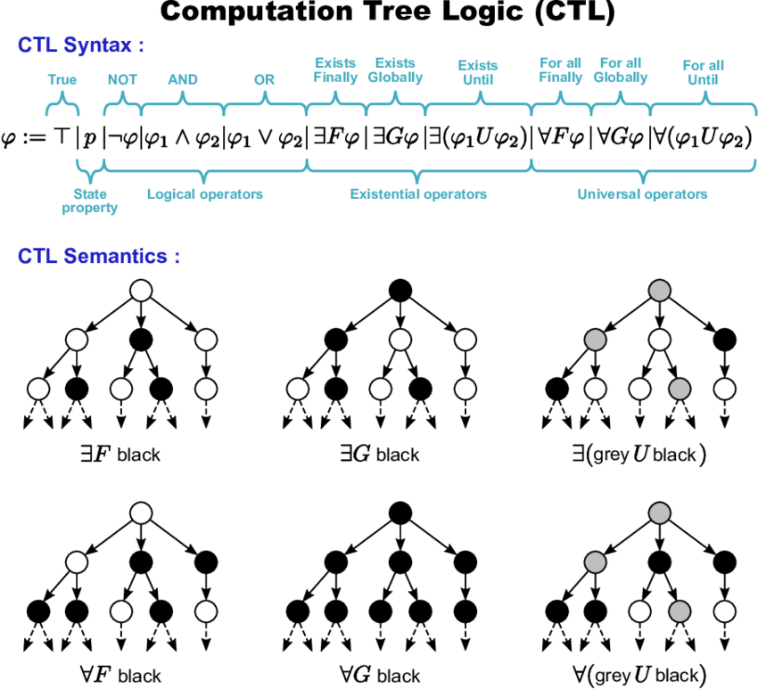
Computation Tree Logic (CTL)
LTL → enables us to talk about linear or sequential requirements that must hold in every execution of a system
CTL → allows us to describe the requirements of computational trees
CTL*: a temporal logic that freely combines temporal operators and path quantifiers → has much expressive power as both CTL and LTL

Slide 11
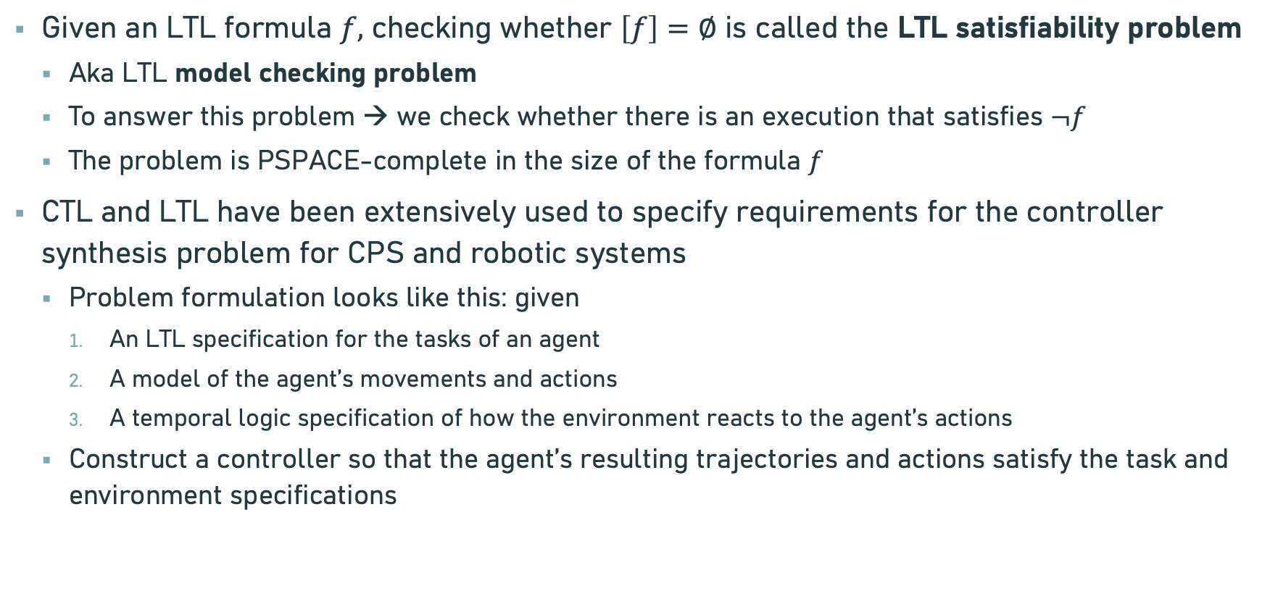
Further Discussions on Temporal Logics
Given an LTL formula $f,$ checking whether $\left[f\right]=∅$ is called the LTL satisfiability problem
Aka LTL model checking problem
To answer this problem → we check whether there is an execution that satisfies $¬f$
The problem is PSPACE-complete in the size of the formula $f$
CTL and LTL have been extensively used to specify requirements for the controller synthesis problem for CPS and robotic systems
Problem formulation looks like this: given
An LTL specification for the tasks of an agent
A model of the agent’s movements and actions
A temporal logic specification of how the environment reacts to the agent’s actions
Construct a controller so that the agent’s resulting trajectories and actions satisfy the task and environment specifications

Slide 12
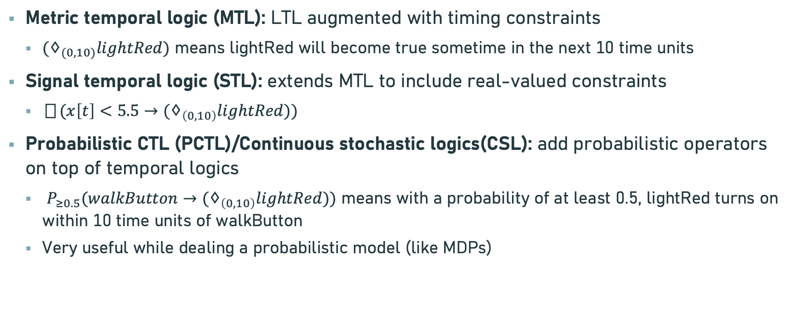
Further Discussions on Temporal Logics
Metric temporal logic (MTL): LTL augmented with timing constraints
$(♢_{(0,10)}lightRed)$ means lightRed will become true sometime in the next 10 time units
Signal temporal logic (STL): extends MTL to include real-valued constraints
$▯(x\left[t\right]<5.5→(♢_{\left(0,10\right)}lightRed))$
Probabilistic CTL (PCTL)/Continuous stochastic logics(CSL): add probabilistic operators on top of temporal logics
$P_{≥0.5}(walkButton→(♢_{\left(0,10\right)}lightRed))$ means with a probability of at least 0.5, lightRed turns on within 10 time units of walkButton
Very useful while dealing a probabilistic model (like MDPs)

Slide 13
Thank You!!!

